Slide 1

CUSTOMER CHURN ANALYSIS
USING MACHINE LEARNING
PRESENTED by :
Sugata kundu ( 12500216019 )
Ushnis panja ( 12500216008 )
GUIDED BY:
Mr. SOUMYAKANTI BHATTACHARYA

Slide 2

OUTLINE
1. SEVERITY OF THE PROBLEM(LITERATURE REVIEW).
2. TRADITIONAL METHODS OF CHURN ANALYSIS.
3. PROPOSED METHOD OF CHURN ANALYSIS.
PART - 1: DATA PREPROCESSING.
PART – 2 : DESIGNING THE NEURAL NETWORK.
PART – 3 : PREDICTING THE TEST SET RESULTS.
PART – 4 : EVALUATING THE MODEL’S PERFORMANCE.
4. FUTURE SCOPE AND CONCLUSIONS.
5. REFERENCES.

Slide 3

1.SEVERITY OF THE PROBLEM
Customer Churn is a serious issue and every year or rather every month most of the big companies and even the small organizations in India and abroad are facing this.
Churning has been a severe problem over the past years due to which many of the companies have faced huge losses and have stopped working.
Though many of the measures had been taken earlier and is still now been taken but all of these measures are being taken after the customer has left the company not before that.
Now, what would have been the scenario if we can predict customer churn at the early stages and take some measures before it occurs ?
In this ever changing world of technology, the answer is “Yes , we can predict customer churn before it occurs with the help of a machine learning model”

Slide 4
2. TRADITIONAL METHODS OF CHURN ANALYSIS
Analyzing why churn occurs.
Engaging with the customers.
Educating the customers.
Knowing who is at risk.
Defining the most valuable customers.
Offering discounts and cashbacks to the customers.

Slide 5

3.PROPOSED METHOD
PART 1 :
DATA PREPROCESSING

Slide 6
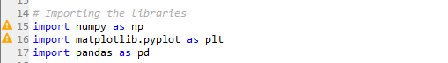
IMPORTING THE LIBRARIES
Numpy
Pandas
Matplotlib

Slide 7
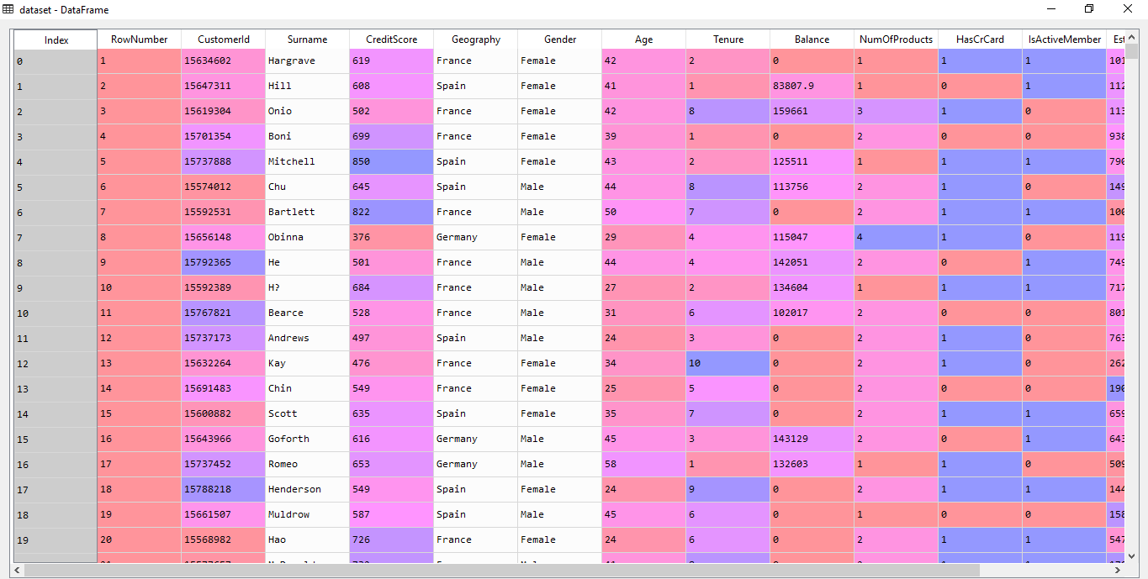
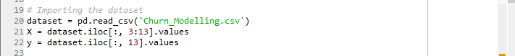
IMPORTING THE DATASET AND ASSIGNING THE FEATURE(INDEPENDENT) VARIABLES AND TARGET(DEPENDENT) VARIABLE
Our dataset contains 10,000 rows and 14 columns.
We need to use the read_csv function of pandas and import our dataset.
Our model is a classification model which means our target variable is classified in binary as: 1 ( people who have exited the bank ) and 0 ( people who have not exited ).
Once imported , we can assign the X and y variables.
Thus, we have divided the data independent variable and dependent variable.

Slide 8
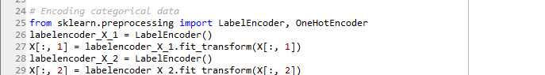
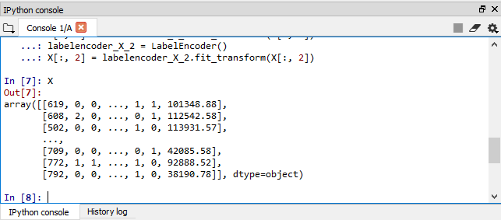
ENCODING THE CATEGORICAL DATA(#1)
Here comes the concept of LabelEncoder class from the Scikit-Learn(or Sklearn) library(or package).
Data containing strings are not suitable for running a model. It needs to be label encoded and transformed into a numerical form.
So we need to encode the 4th( Geography ) and 5th(Gender) columns to a numeric form

Slide 9
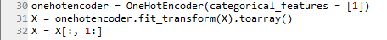
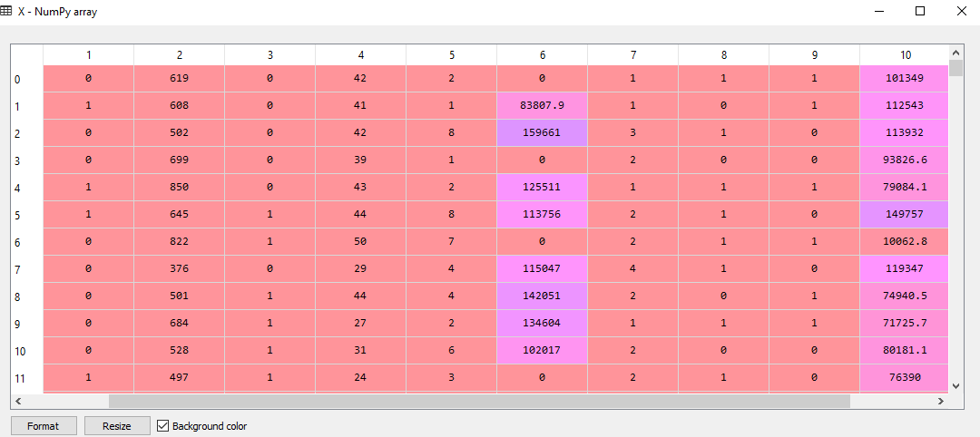
ENCODING THE CATEGORICAL DATA(#2)
But this label encoded data has some problems.
The Geography column has been encoded as 0(for France),1(for Germany) and 2(for Spain) which is terrible for a model as it might get confused that it may represent a hierarchy.
To prevent the model from getting confused, we have OneHotEncoder method from sklearn which splits the Geography column into 2 columns

Slide 10
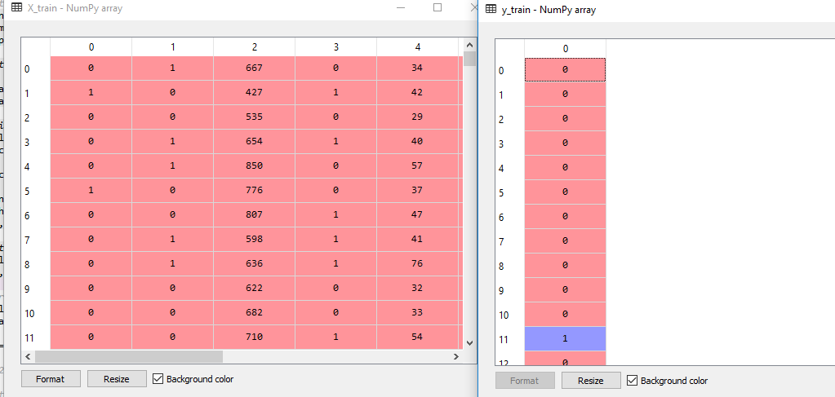
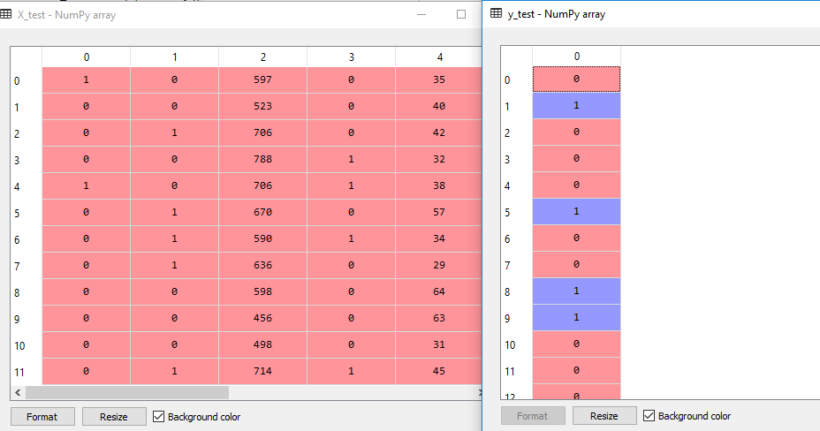
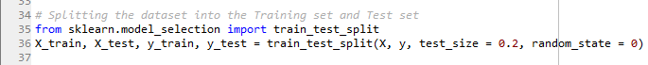
SPLITTING THE DATASET
The Dataset needs to be divided into training and test set using the train_test_split() method of Scikit Learn.
We train our model with the train set and test our model using the test set.

Slide 11
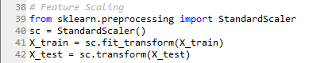
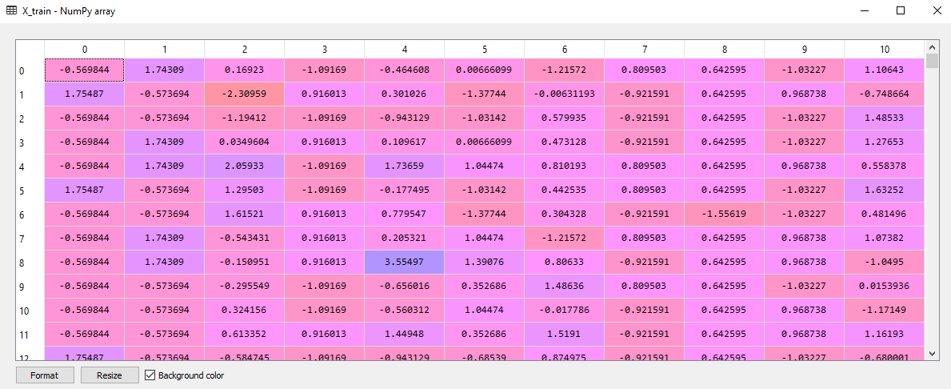
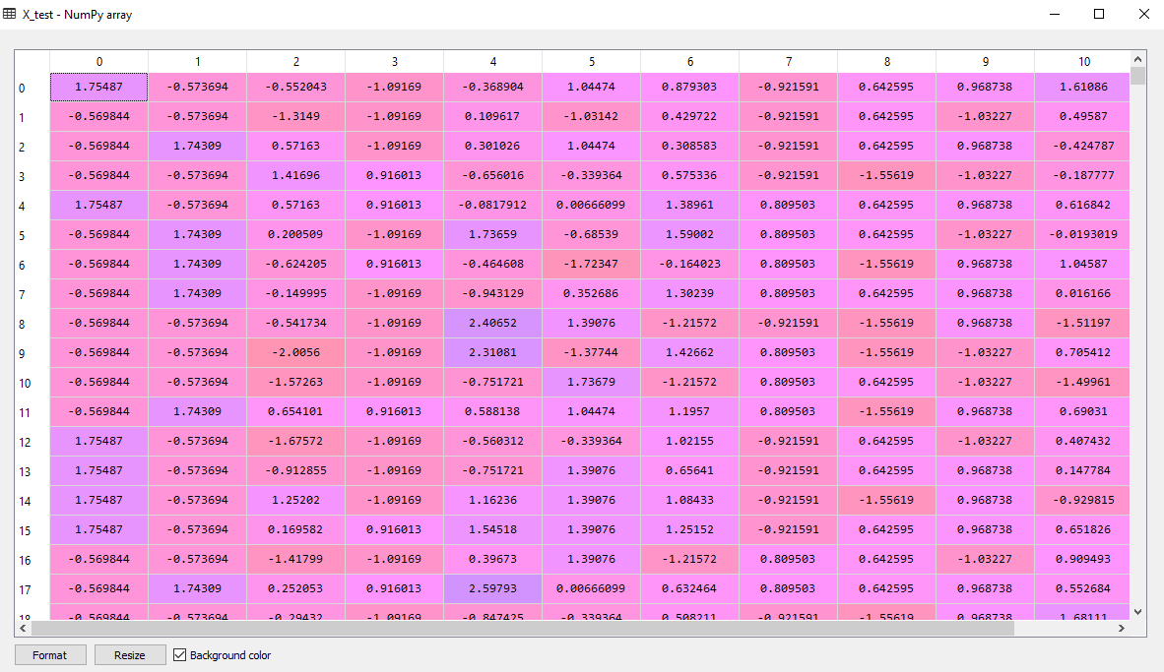
FEATURE SCALING
If we carefully look at the data, we will observe that the data is not scaled properly. Some of the features have values in hundreds and thousands while some of them are in tens or units.
Data in this form is not eligible for analysis.
Standard Scaler() method from sklearn is used to fit and transform our train data.
We also need to standardize our scaling and thus we also need to apply the same fitted method to transform/scale the test data.

Slide 12

PART 2 :
DESIGNING THE NEURAL NETWORK

Slide 13


WHAT IS A NEURAL NETWORK ?
Input 1
Input 2
Output
Input 3
TAKE
IN DATA
Output Layer
PREDICT THE OUTPUT FOR A FUTURE SET OF DATA
Hidden Layer
Input n
Input Layer
TRAIN THEMSELVES TO RECOGNIZE PATTERNS IN DATA

Slide 14
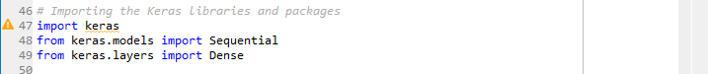
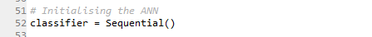
IMPORTING KERAS : THE PYTHON DEEP LEARNING LIBRARY & INITIALIZING THE NEURAL NETWORK
We need Sequential module for initializing the neural network and Dense module to add the hidden layers.
We are giving our model name as “classifier”. Using the Sequential module for initialization we have the following code :

Slide 15

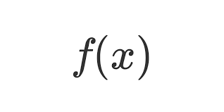
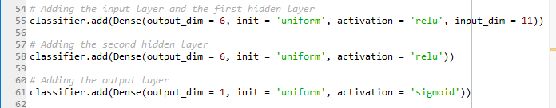
ADDING THE LAYERS
Fig. Working Of The Neural Network
Our first parameter is output_dim which signifies the number of nodes we want to add to this layer.
init is the initialization of the Stochastic Gradient Descent(SGD).
We need to assign weights to each node, which is nothing, but the importance given to each node.
input_dim parameter is needed only for first layer as the model does not know the number of input variables.
Neuron applies Activation Function to weighted sum(sum of Wi * Xi). The closer the activation function value is to 1 the more activated is the neuron.
Inputs
Weights
x1
w1
Bias
B
Activation
Function
x2
w2
Output
(wi * xi) + B
x3
w3

Slide 16
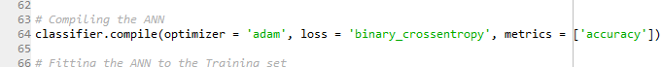
COMPILING THE NEURAL NETWORK
First argument is Optimizer i.e. the iterative algorithm needed to find the optimal set of weights. Previously we had just initialized the weights and now we are optimizing the algorithm by updating the weights to reduce the loss function. This algorithm is called the Stochastic Gradient Descent ( SGD ).
Among several SGD algorithms available we are going to use Adam.
And SGD depends on loss, which is nothing but the error in prediction, and since our dependent(target) variable is in binary, we will use the logarithmic loss function binary_crossentropy.
To improve the performance of our neural network, we need to improve the accuracy, so we would add accuracy as metrics

Slide 17
FITTING THE ANN INTO THE TRAINING SET
We will use the fit method to fit our model into the training set.
We also need to update and optimize our weights in order to improve the efficiency of our neural network. batch_size is used to specify the number of observations after we would update our weights.
nb_epoch is a hyperparameter which defines the number of times an entire dataset is passed both forward and backward through the neural network once.
Choosing the value of batch_size and nb_epoch is a trial and error process.

Slide 18

PART 3 :
PREDICTING THE TEST SET RESULTS

Slide 19
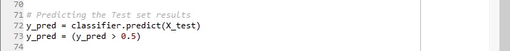
PREDICTING THE TEST SET RESULTS
Predicting the results with the test set will give the probability of the number of customers leaving the company( customer churn ).
We need to covert the results into binary.

Slide 20

PART 4:
EVALUATING
THE
MODEL’S PERFORMANCE

Slide 21
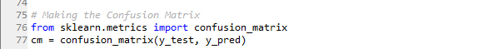

EVALUATING THE PERFORMANCE THROUGH CONFUSION MATRIX
Confusion Matrix comes into the picture while measuring the effectiveness(or performance) of our model through RECALL, PRECISION, ACCURACY & AUC-ROC Curve(discussed later).
We have,
RECALL = TP/TP+FN
PRECSION = TP/TP+FP
ACCURACY
= TP+TN/Actual values + Predicted values
Fig. Confusion Matrix Analogy

Slide 22
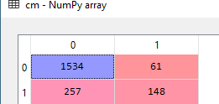
CONFUSION MATRIX INTERPRETATION
The model predicted that 1534 people are present in the bank, which is correctly classified.
The model predicted that 148 people have left the bank which is again correctly classified.
The model predicted that 257 people have left the bank, which is mis-classified, in accordance with the actual values.
The model predicted that 61 people have not left the bank, which is again misclassified, in accordance with the actual values.
Fig. Confusion Matrix
RECALL = 1534/1534+257=0.85
PRECISION = 1534/1534+61=0.96
ACCURACY
=1534 + 148/1595+405=11682/2000=0.84=84%

Slide 23
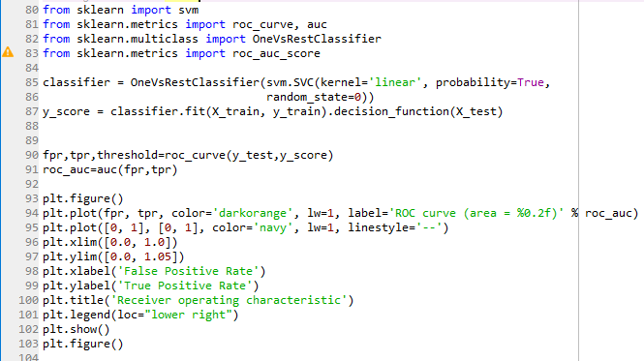
EVALUATING THE PERFORMANCE THROUGH AUC-ROC CURVE
The ROC(Receiver Operating Characteristics) is a probability curve which is the common way to visualize the performance of a binary classifier.
The AUC(Area Under Curve) represents the degree or measure of separability which summarizes the performance in a single number.
Higher the AUC, better the model is at distinguishing 0’s as 0’s and 1’s as 1’s(i.e. between churn as churn and no churn as no churn).

Slide 24
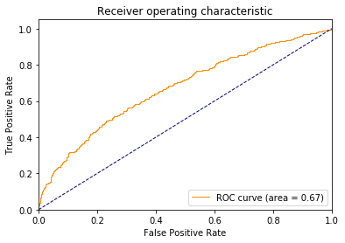
AUC-ROC CURVE INTERPRETATION
The ROC Curve is plotted with TPR(True Positive Rate) on the y-axis against FPR(False Positive Rate) on the x-axis.
TPR (True Positive Rate) / Recall / Sensitivity calculated as the number of correct positive predictions divided by the total number of positives = TP / TP + FN
Specificity (True Negative Rate) calculated as the number of correct negative predictions divided by the total number of negatives = TN / TN + FP
FPR (False Positive Rate) = 1 – Specificity = FP / TN + FP
An excellent model has AUC near to the 1 which means it has good measure of separability. A poor model has AUC near to the 0 which means it has worst measure of separability. In fact, it means, it is reciprocating the result. It is predicting 0s as 1s and 1s as 0s. And when AUC is 0.5, it means model has no class separation capacity whatsoever.
AUROC = 0.67
with
TPR = 0.85
FPR = 0.19

Slide 25
4.FUTURE SCOPE AND CONCLUSIONS
The analysis focused on churn prediction based on binary classification with artificial neural network. The model predicted the actual churners relatively well.
The differences between the model’s input data (the significance level in case of each of the variables) indicates the dynamic nature of the churning customer profile. This makes it hard to formulate one standard model that could be used as the predictive model in the future.
The findings of this study indicate that, in case of neural network model, the user should update the hyperparameters of the network to be able to produce predictions with high accuracy.
The customer churn analysis in this study might not be interesting if the customers are valued based on the customer lifetime value. The churn definition in this study was based on the current account. But if the churn definition was based on for example loyalty program account or active use of the internet service. Then the customers at focus could possibly have greater lifetime value and thus it would be more important to retain these customers.

Slide 26
5.REFERENCES
https://www.vttresearch.com/sites/default/files/julkaisut/muut/2006/customer_churn_case_study.pdf
https://www.kdnuggets.com/2017/10/neural-network-foundations-explained-gradient-descent.html
https://medium.com/@pushkarmandot/build-your-first-deep-learning-neural-network-model-using-keras-in-python-a90b5864116d
https://towardsdatascience.com/understanding-auc-roc-curve-68b2303cc9c5
https://machinelearningmastery.com/roc-curves-and-precision-recall-curves-for-classification-in-python/
https://ethen8181.github.io/machine-learning/model_selection/auc/auc.html
https://scikit-learn.org/stable/auto_examples/model_selection/plot_roc.html
https://towardsdatascience.com/understanding-confusion-matrix-a9ad42dcfd62

Slide 27

THANK YOU

